Slide 1
welcome!
MOVING EVERY LIFE FORWARD
THIS MEETING WILL START SHORTLY
JAN. 26, 2023

Slide 2
MEETING PURPOSE
2
THANK YOU FOR JOINING US AND
participating.
MOVING EVERY LIFE FORWARD |
The purpose of this meeting is to take public comments on the proposed service changes that will take effect on May 1, 2023
No final decisions have been made for the May 2023 service changes.

Slide 3
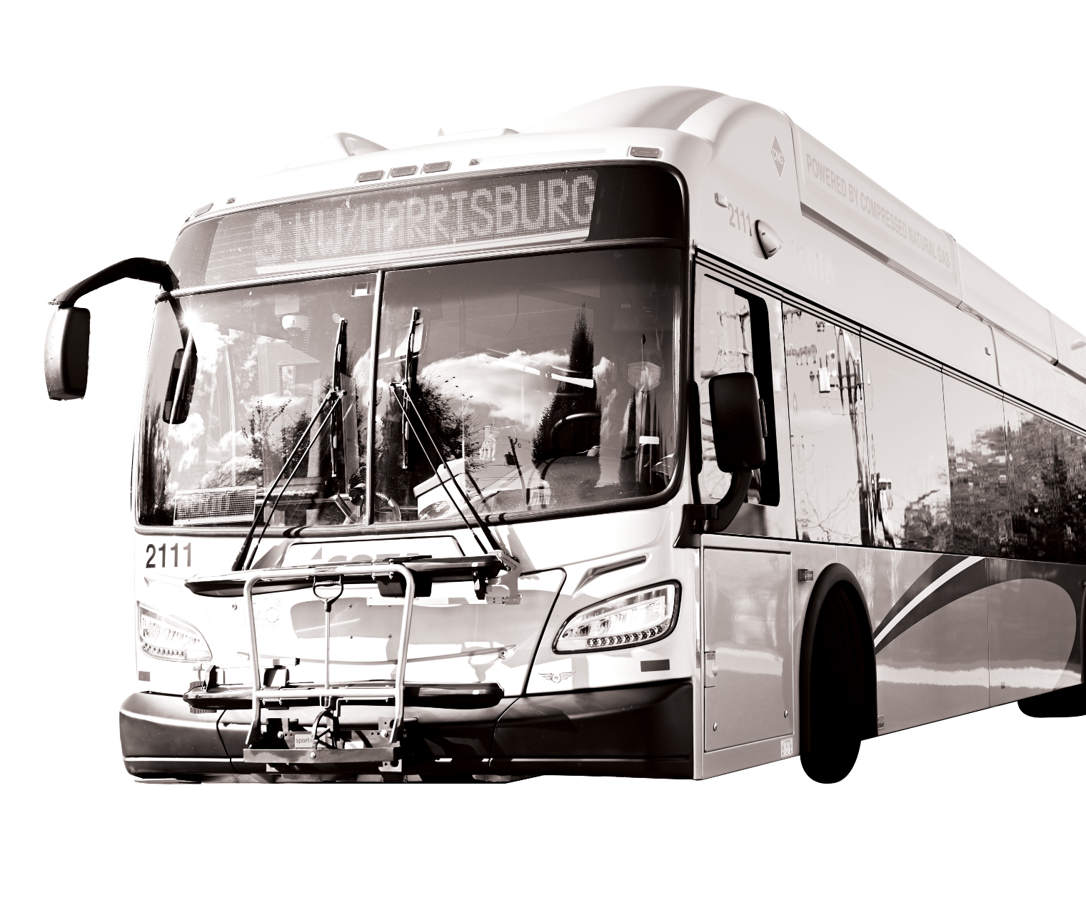
Meeting Format
We are recording this meeting. The recording will be posted on our website at COTA.com. If you are joining us by computer or phone, please know we cannot see or hear you. Please be considerate of meeting attendees and COTA staff.
MOVING EVERY LIFE FORWARD |
HOW TO COMMUNICATE WITH COTA
If joining by computer, submit comments and questions via the Q&A chat box. If joining by phone, please direct all questions or comments to COTA’s Customer Care Center at 614-228-1776. If joining by Facebook Live, please submit your question by commenting in the livestream.

Slide 4
How to Use Q&A Chat
MOVING EVERY LIFE FORWARD |
\+
032\+

Slide 5
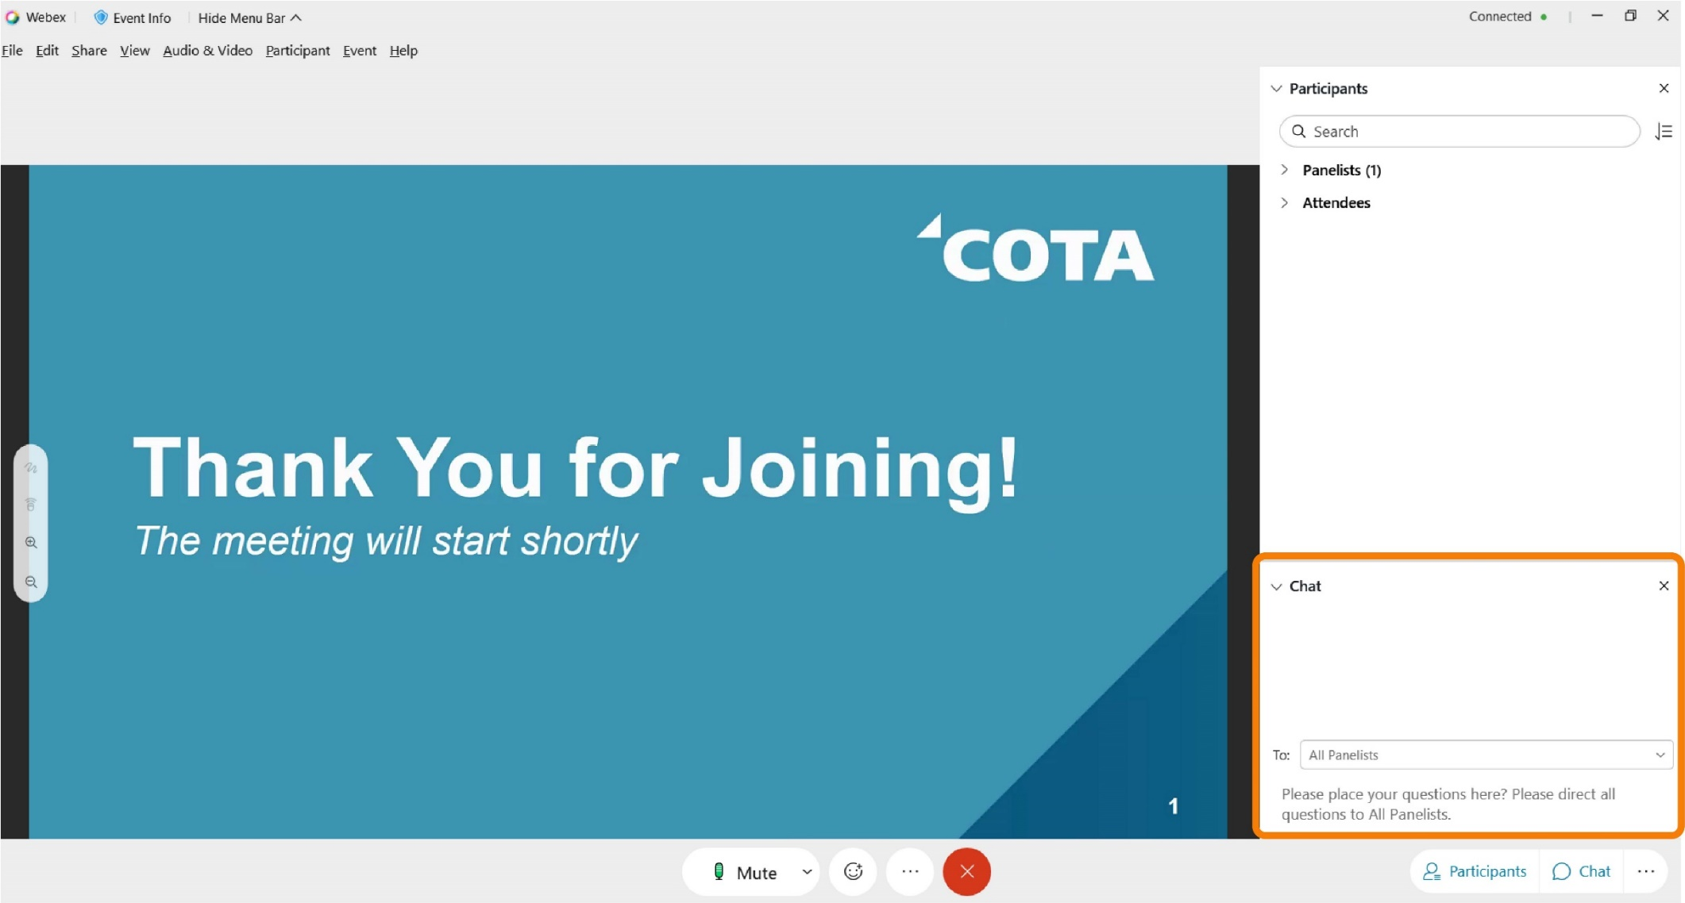
How to Use Q&A Chat
MOVING EVERY LIFE FORWARD |

Slide 6
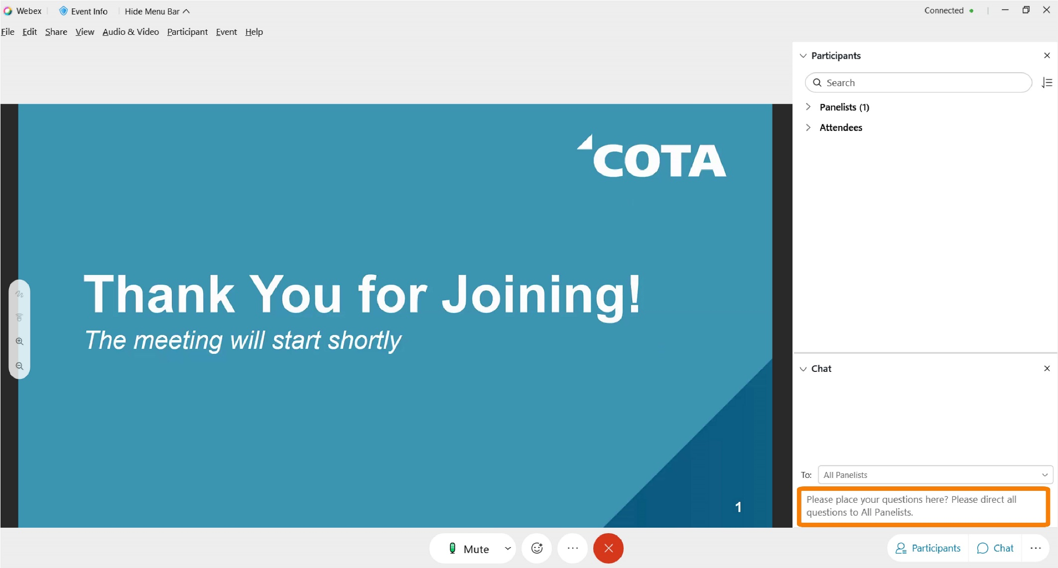
How to Use Q&A Chat
MOVING EVERY LIFE FORWARD |

Slide 7
Workforce Challenges & Reduced Service
Like most organizations, COTA is impacted by the nationwide worker shortage. COTA continues to recruit and hire new Transit Operators, but those new hires have not been enough to offset retirements and other departures.
COTA will continue to adjust transit schedules due to unprecedented workforce challenges. The adjustments will be made to improve service reliability and help minimize adverse service impacts to our customers and staff.
We hope to begin adding service in future trimesters when we are able to hire, train and retain more Operators.
MOVING EVERY LIFE FORWARD |

Slide 8
Recruitment
Transit agencies across the nation are facing a shortage of Operators, which has resulted in reduced service. COTA has embarked on a robust recruitment campaign to address workforce needs throughout the organization and return to normal service hours as soon as possible. Efforts include:
A revamped and revitalized careers landing page
Internal and external recruitment incentives, including monetary referral and hiring bonuses upwards of $2,000
Making candidates with Commercial Drivers Licenses (CDL) eligible to receive $2,500 signing bonuses
A strategic marketing communications campaign that boasts benefits and increased wages
Partnering with local and state organizations to host hiring events

Slide 9
COTA is HIRING!
Anyone interested in a rewarding career at COTA can learn more and apply at COTA.com/careers.
COTA's Operator wages start at $21.10/hour. Operators can make more than $33/hour in 5 years.
Comprehensive insurance: medical, dental, vision
Health flexible spending accounts
Retirement/savings benefits: Ohio Public Employees Retirement System (OPERS), Deferred Compensation Plan
Vacations, holiday, sick pay
NEW: 12 weeks paid family leave
NEW: Domestic partner benefits
NEW: Monthly student loan payment stipend (after 6 months)
Biometric screening, fitness and wellness reimbursement
Personal training and development, job advancement and Employee Assistance Program (EAP)
MOVING EVERY LIFE FORWARD |

Slide 10
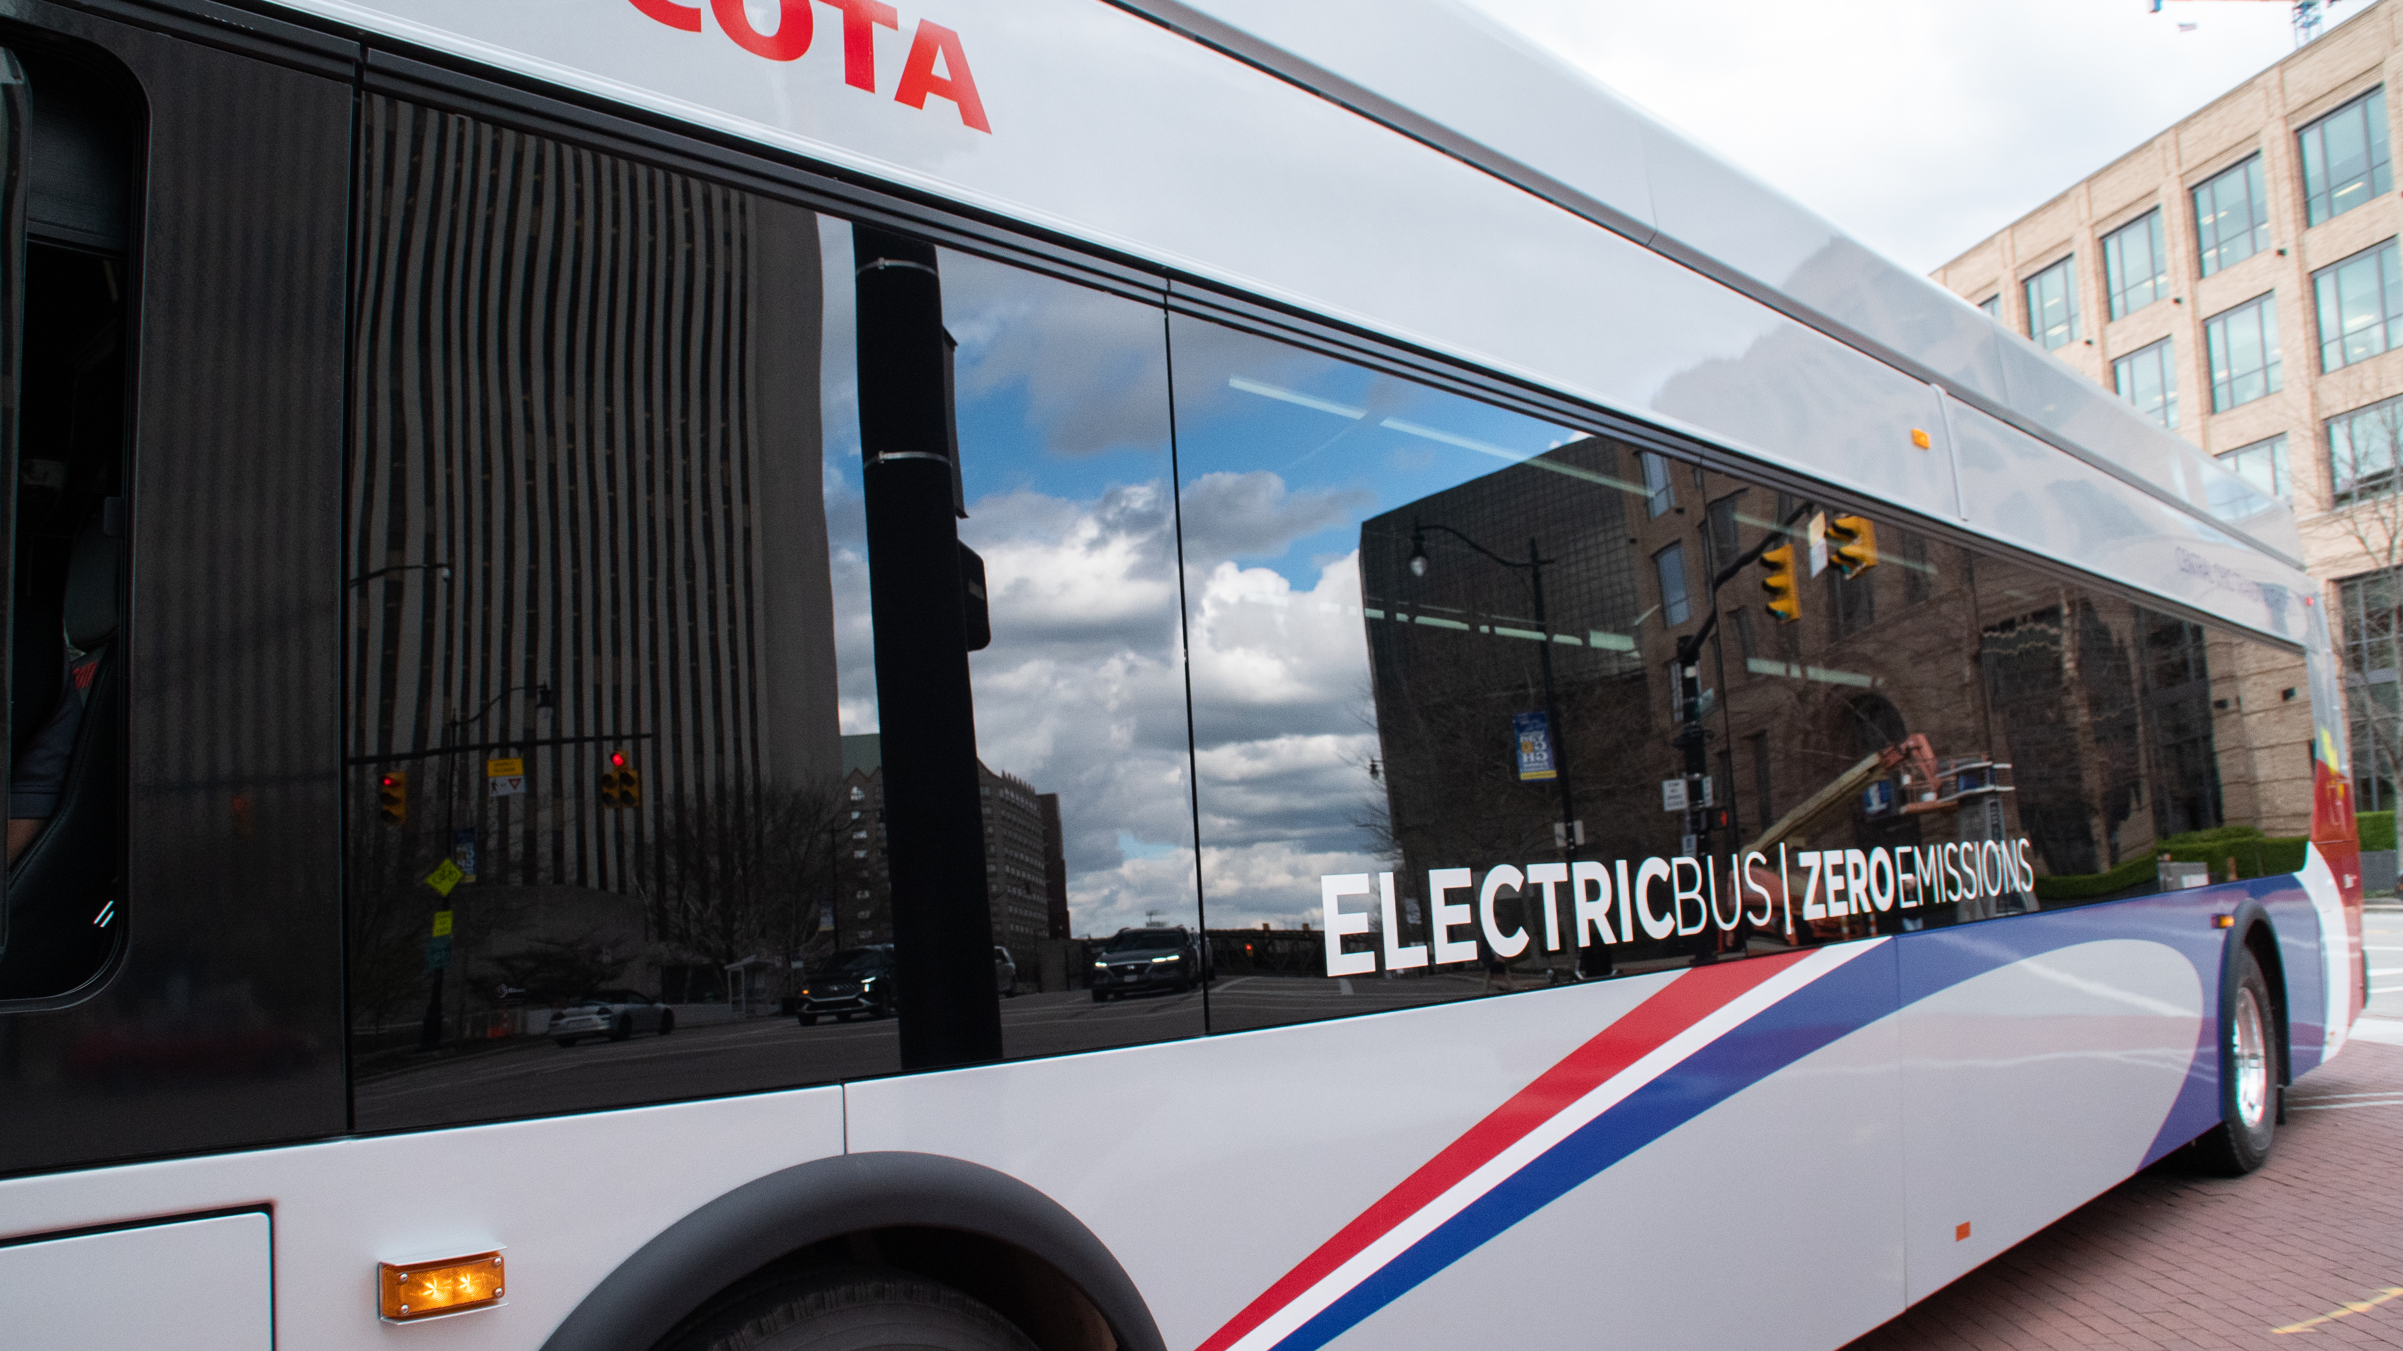
10
service
CHANGES
MOVING EVERY LIFE FORWARD |
The following service adjustments are proposed to begin on Monday, May 1, 2023.
No final decisions have been made for the May 2023 Service Changes.

Slide 11
Frequency Adjustments
LINES | LINE NAME | CURRENT FREQUENCY | PROPOSED CHANGES
1 | Kenny / Livingston | Reduced frequency before 7 a.m. 15 minutes between Reynoldsburg and Riverside Hospital & 30 minutes between Riverside Hospital and Carriage Place on Saturday 20 minutes between Reynoldsburg and Riverside Hospital & 40 minutes between Riverside Hospital and Carriage Place on Sunday | No change to weekday service 20 minutes between Reynoldsburg and Riverside Hospital & 40 minutes between Riverside Hospital and Carriage Place on Saturday 30 minutes on Sunday. Vehicles would not short turn
2 | E Main / N High | Reduced frequency before 7 a.m. 15 minutes between Westview Turnaround and Great Eastern & 30 minutes between Great Eastern and Main & Hanson on Saturday 20 minutes between Westview Turnaround and Great Eastern & 40 minutes between Great Eastern and Main & Hanson on Sunday | No change to weekday service 20 minutes between Westview Turnaround and Great Eastern & 40 minutes between Great Eastern and Main & Hanson on Saturday 30 minutes on Sunday. Vehicles would not short turn
10 | E Broad / W Broad | Reduced frequency before 7 a.m. 15 minutes between Westwoods and Mt. Carmel East Hospital & 30 minutes between Mt. Carmel and Limited Brands on Saturday 20 minutes between Westwoods and Mt Carmel East Hospital & 40 minutes between Mt. Carmel and Limited Brands on Sunday | No change to weekday service 20 minutes between Westwoods and Mt. Carmel East Hospital & 40 minutes between Mt. Carmel and Limited Brands on Saturday 30 minutes on Sunday. Vehicles would not short turn
CMAX |  | Reduced frequency before 7 a.m. 15 minutes between downtown and Northland Transit Center & 30 minutes between Northland and Westerville on Saturday​ 20 minutes between downtown and Northland Transit Center & 40 minutes between Northland and Westerville on Sunday | No change to weekday service 20 minutes between downtown and Northland Transit Center & 40 minutes between Northland and Westerville on Saturday 30 minutes on Sunday. Vehicles would not short turn
Notes:
Methodology -Recommendations were made after reviewing trips on each line….removing singular trip will not have enough impact on reducing the amount operators needed

Slide 12
Frequency Adjustments
LINES | LINE NAME | CURRENT FREQUENCY | PROPOSED CHANGES
8 | Karl / S High / Parsons | 15 minutes between Boardwalk & Shapter and downtown & 30 minutes south of downtown seven days a week | 20 minutes between Boardwalk & Shapter and downtown & 40 minutes south of downtown Monday through Saturday 30 minutes between Boardwalk & Shapter and downtown & 60 minutes south of downtown on Sunday
22 | OSU-Rickenbacker | 15 minutes south of Broad Street and 30 minutes remainder Monday through Friday 30 minutes Saturday 40 minutes Sunday | No change to service Monday-Saturday 30 minutes on Sunday
Disclaimer: Lines may be added or removed as on-time performance information becomes available.
All changes are proposed. No final decisions have been made for the May 2023 Service Changes.

Slide 13
Schedule Adjustments
LINES | LINE NAME | CHANGES
5 | W. Fifth Ave / Refugee | Minor scheduling adjustments Monday-Friday
CMAX |  | Minor scheduling adjustments Monday-Friday *Staff will review stop spacing on Cleveland Avenue

Slide 14
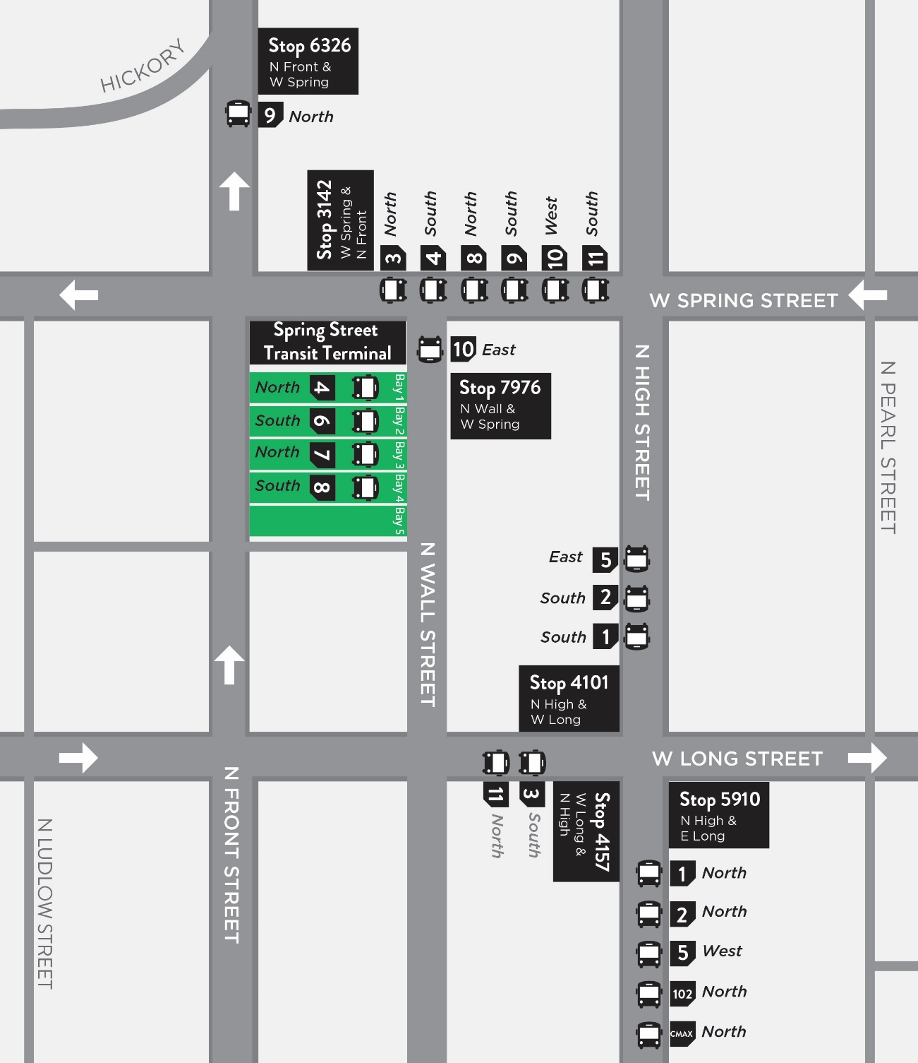
Facilitating Easy Transfers
LATE NIGHT &
SUNDAY LINEUPS
Based on passenger feedback, COTA is proposing downtown lineups on Sundays for Lines 1–11, 102 and CMAX.
Similar to late-night lineups, local lines will meet at designated locations near Spring Street Terminal in downtown Columbus to make transferring quick and easy. All impacted COTA vehicles would dwell for 10 minutes at their locations to allow customers enough time to transfer between lines.
Notes:
Riders let COTA know that reduced service frequencies make it harder to transfer between buses.
Beginning in January 2023 COTA will operate Late Night Lineups for Lines 1-12, 102, and CMAX all day on Sundays. Late Night Lineups are times when buses meet at designated locations near Spring Street Terminal in downtown Columbus to make transferring quick and easy. All impacted buses will dwell for 10 minutes at their locations to allow riders enough time to transfer between lines. See schedules for detailed line information.
Multiple routes serve each lineup location. It is important to look for your connecting bus anywhere along the block.

Slide 15
Facilitating Easy Transfers
30-MINUTE LINEUPS
SUNDAY
All frequent lines would be reduced to run 30 minutes all day on Saturday & Sunday
LINES ​ | LINE NAME​ | FREQUENCY CHANGE​
1​ | ​Kenny / Livingston | 30 minutes Saturday/Sunday
2​ | ​E Main / N High | 30 minutes Saturday/Sunday
5 | ​W Fifth Ave / Refugee | 30 minutes Saturday/Sunday
6​ | ​Sullivant | 30 minutes Saturday/Sunday
7 | Mt Vernon | 30 minutes Saturday/Sunday
8 | Karl / S High / Parsons | 30 minutes Saturday/Sunday
10​ | ​E Broad / W Broad | 30 minutes Saturday/Sunday
CMAX |  | 30 minutes Saturday/Sunday
Based on passenger feedback, COTA is proposing downtown lineups on Sundays for Lines 1–11, 102 and CMAX.
Similar to late-night lineups, local lines will meet at designated locations near Spring Street Terminal in downtown Columbus to make transferring quick and easy. All impacted COTA vehicles would dwell for 10 minutes at their locations to allow customers enough time to transfer between lines.
60-MINUTE LINEUPS
SUNDAY
All frequent lines would be reduced to run 30 minutes all day on Saturday & Sunday
LINES ​ | LINE NAME​ | FREQUENCY CHANGE​
3​ | ​Northwest / Harrisburg | 60 minutes Saturday/Sunday
4​ | ​Indianola / Lockbourne | 60 minutes Saturday/Sunday
9 | W Mound / Brentnell | 60 minutes Saturday/Sunday
11 | Bryden / Maize | 60 minutes Saturday/Sunday
102 | N High / Polaris Pkwy | 60 minutes Saturday/Sunday

Slide 16
Line 12 Routing Change
COTA’s McKinley Operations Center will close on Saturday and Sunday.
COTA is proposing Line 12 operate between the Fields and McKinley Avenue facilities on weekdays only.
Line 12 would operate between the Fields Operations Center and downtown Columbus, laying over near North Front Street and Gay Street on Saturday and Sunday.
Customers impacted by this change are encouraged to use Line 10 for travel along West Broad Street.
MOVING EVERY LIFE FORWARD |
Notes:
"Because the McKinley Operations Center will be closed on weekends Line 12 will not travel between McKinley Operations Center and downtown Columbus on weekends. Service to McKinley Operations Center will operate on weekdays only. Line 12 service between Fields Operations Center and downtown Columbus will run seven days a week." That text would just be for the first 2 paragraphs. I don't know if it is any clearer but putting it in my old words helps me understand it at least.

Slide 17
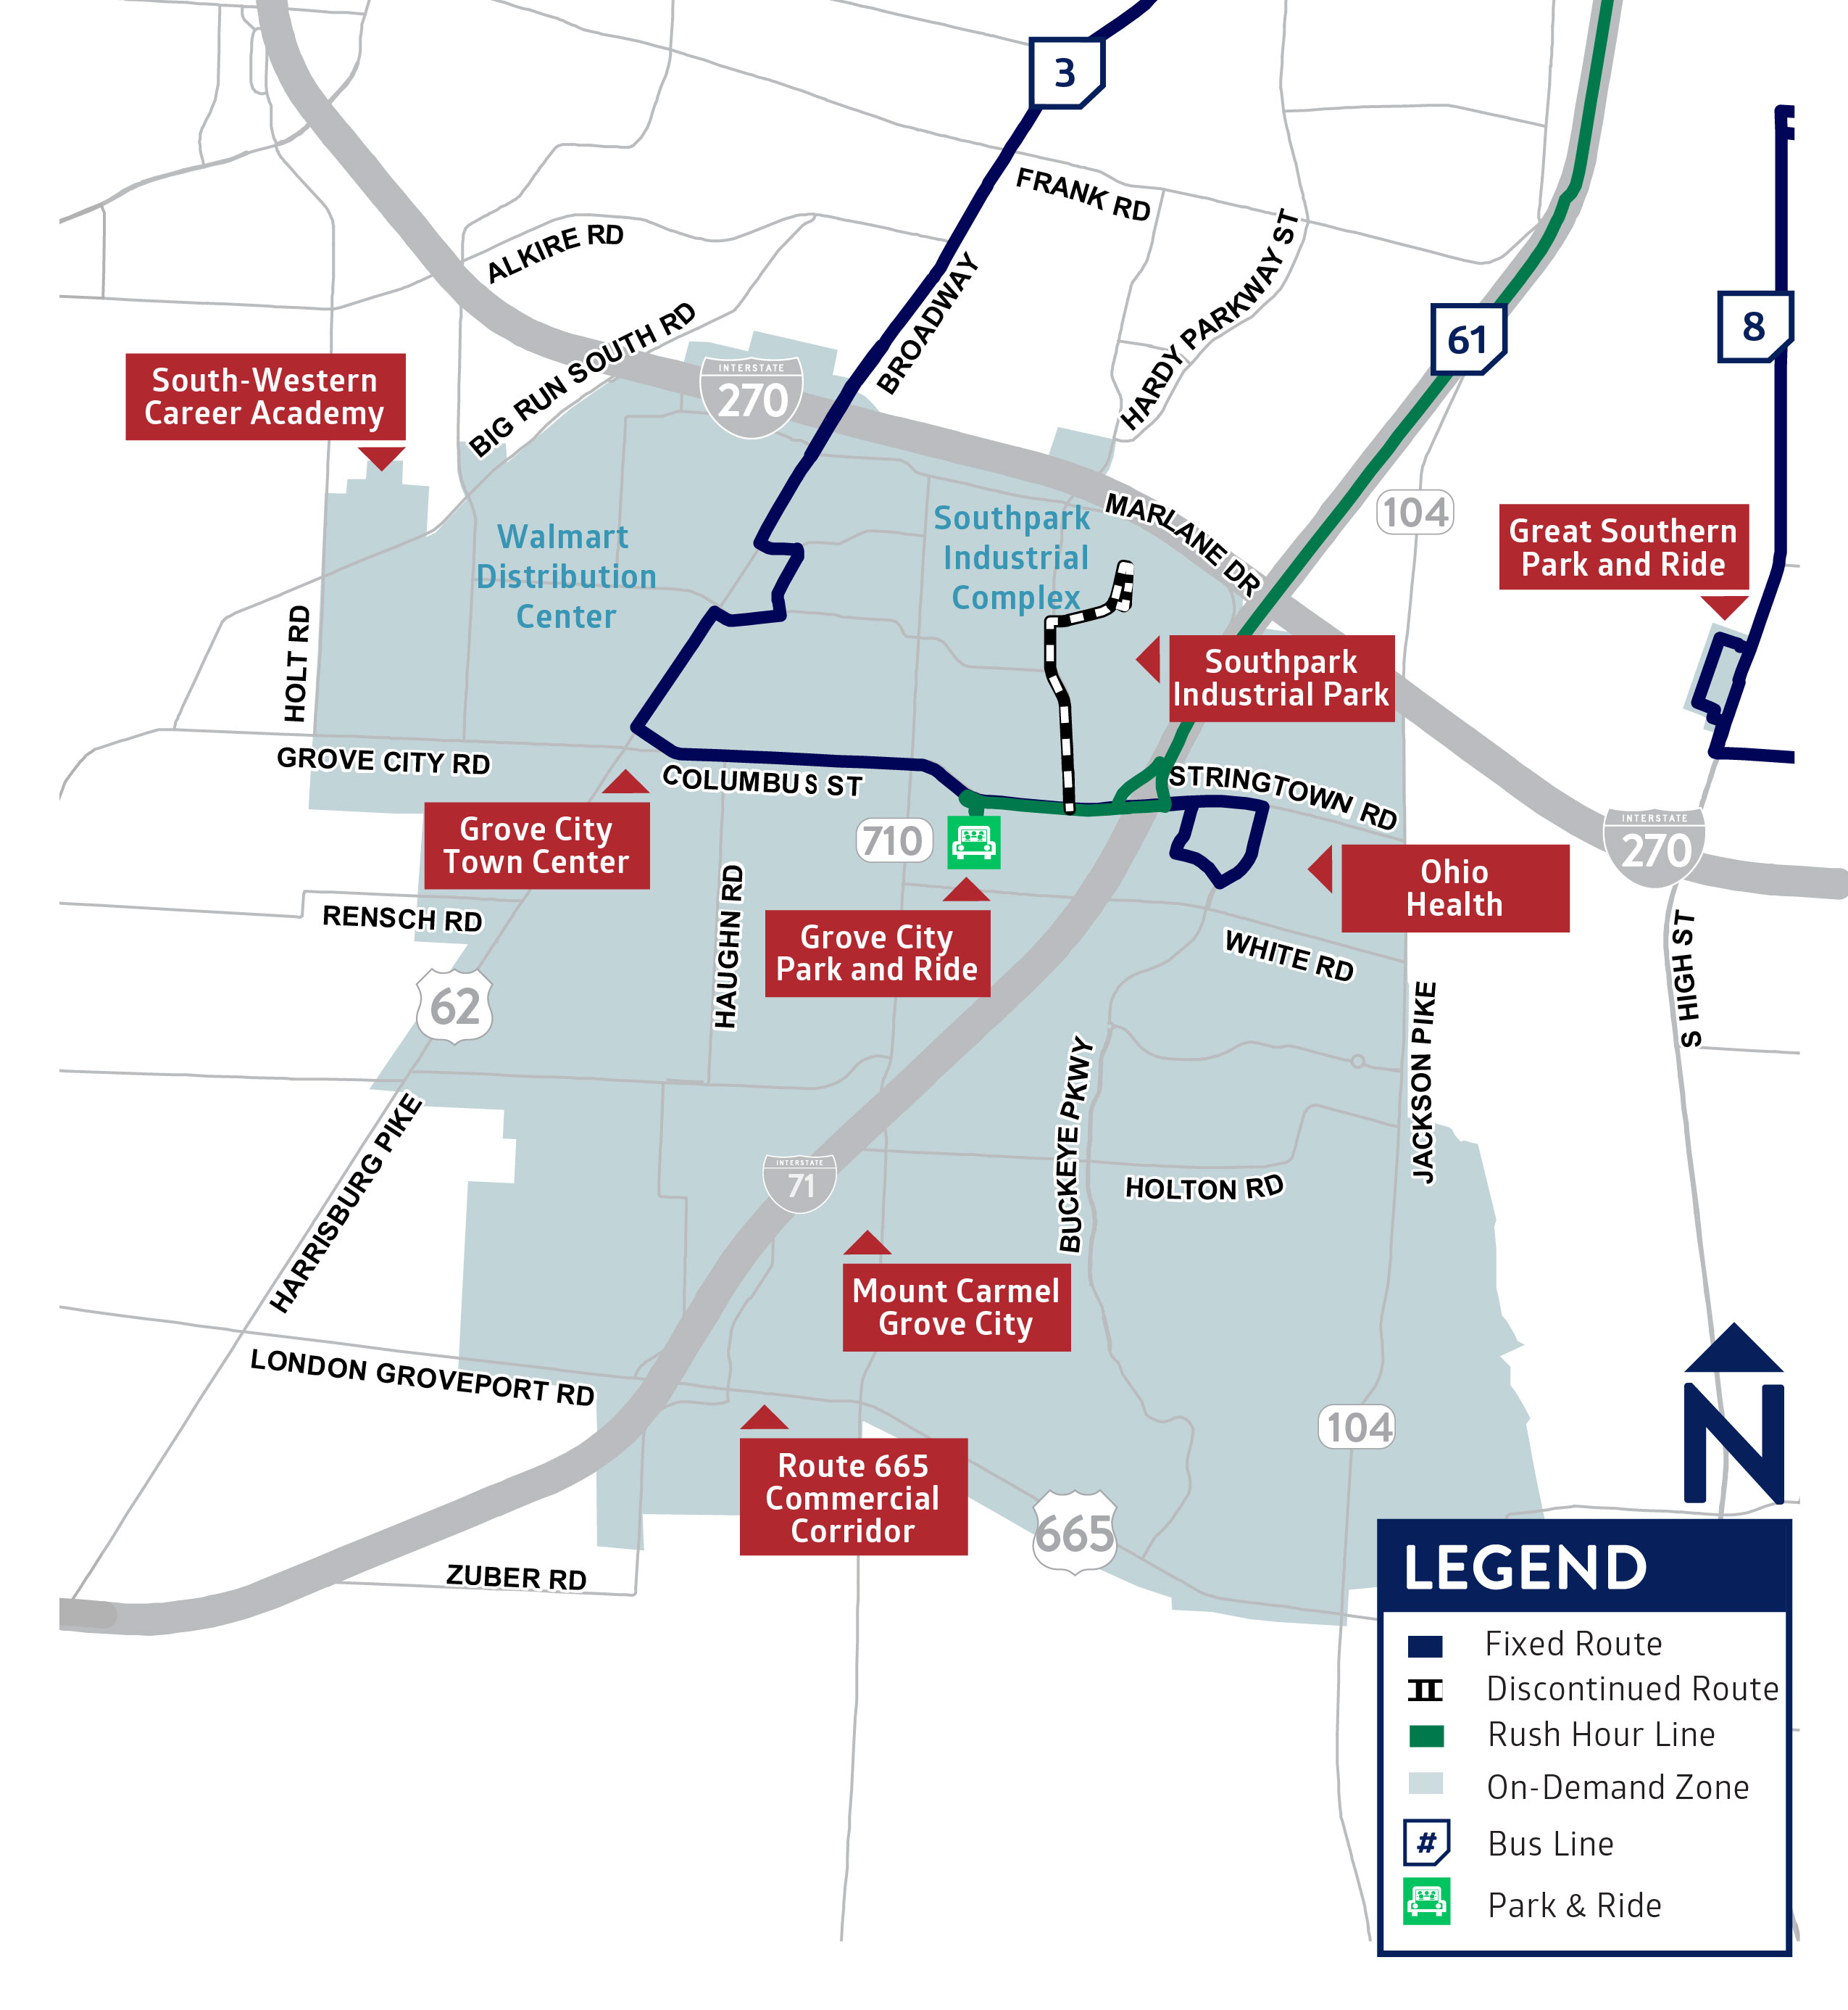
Line 61 Routing Change
Due to historically low ridership, COTA is proposing to remove Line 61 from Gantz Road.
Instead, Line 61 would remain on Stringtown Road in both directions. Stops along Gantz Road and Southpark Place would permanently close.
Customers impacted by this change are encouraged to use COTA//Plus Grove City zone for travel into the Southpark Industrial Complex. COTA//Plus Grove City operates from 5:30 a.m. to 8 p.m. Monday-Friday. Customers can request a ride using the COTA//Plus mobile app or by calling Customer Service at 614-308-4400.
MOVING EVERY LIFE FORWARD |

Slide 18
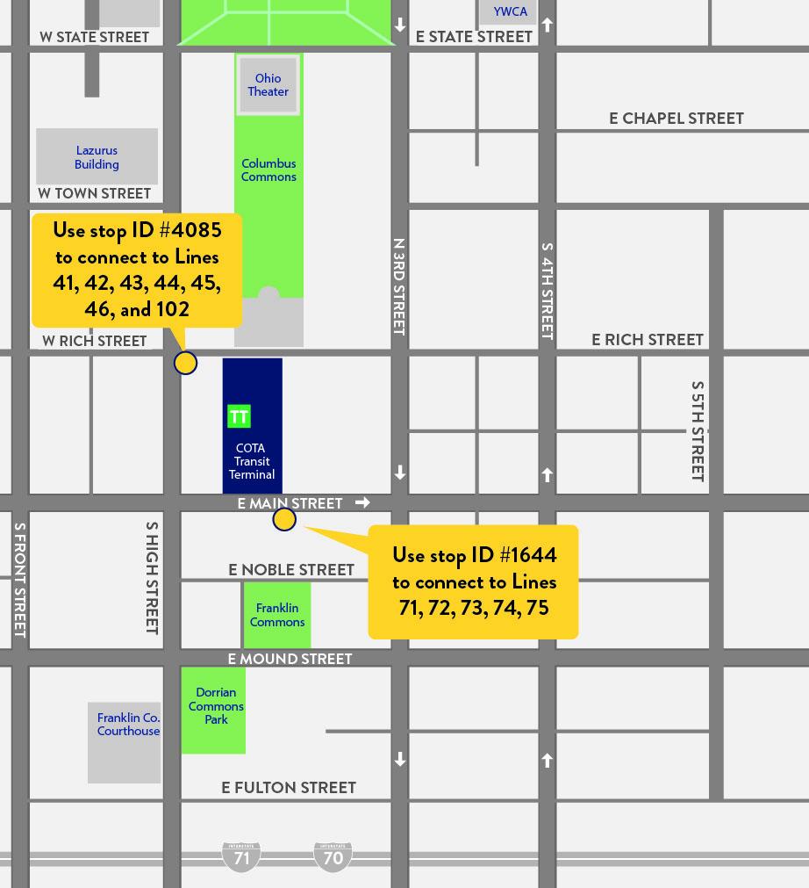
New End of Line
COTA is proposing a new downtown layover for Lines 41-46, 71-75 and 102.
Lines would no longer use the COTA Transit Terminal located on East Rich Street.
Catch Lines 41-46 and 102 near the intersection of South High Street & East Rich Street.
Catch Lines 71-75 near East Main Street & South High Street, directly behind the COTA Transit Terminal.
Passes are available for purchase by visiting COTA's Customer Experience Center at 33 N. High St.

Slide 19
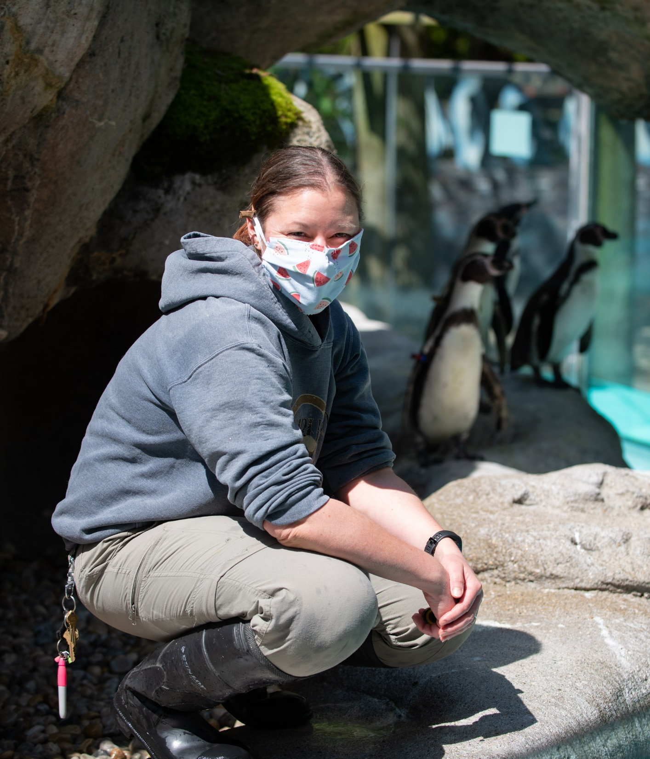
Zoo Bus Service
COTA’s seasonal Zoo Bus will return May 2023!
Zoo service begins Saturday, May 6 and operates on weekends until Memorial Day. Beginning Memorial Day, May 29 and running through Labor Day, Sept. 4, the Zoo Bus will operate seven days a week.
Zoo Bus operates according to the holiday/Sunday schedule on Memorial Day, Independence Day, and Labor Day.
For more information about COTA Zoo Bus service, visit COTA.com/ZooBus or call (614) 228-1776. For Zoo and Zoombezi Bay hours visit columbuszoo.org.

Slide 20
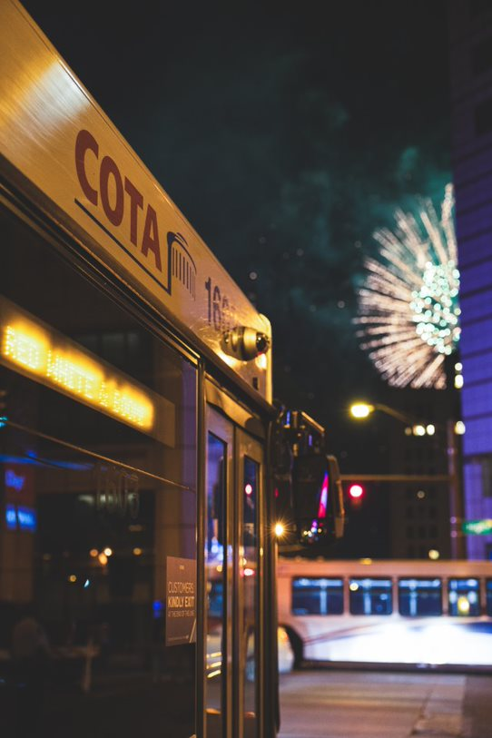
Red, White & BOOM! Service
Zoom to BOOM! with COTA
COTA offers the safest, easiest and most affordable way for you and your family to get to Red, White & BOOM! For just $4 round trip, you can skip the traffic and pricey parking and get dropped off right at the celebration.

Slide 21
How to get involved in future service changes
​
MOVING EVERY LIFE FORWARD |
We welcome questions about our service changes, reactions to our methodology and ideas about how we can continue to search for service solutions that better meet our community needs.
Final service changes will be announced on
Thursday, April 13 at 6 p.m. and Tuesday, April 18 at noon
Tell us what you think!
Your voice is crucial to COTA’s success. Visit COTA.com/contact to suggest how we can improve COTA’s service.
Notes:
March 1 – September 1

Slide 22
Q&A Chat
Have a question about the proposed service changes?
If joining via WebEx, submit comments via the chat box.
If joining via phone, please wait to unmute yourself until directed by the moderator.
If joining via Facebook Live, please comment with questions in the livestream.
Visit COTA.com/contact to suggest how we can improve COTA’s service.
​
Final service changes will be announced at May 2023 Service Change meetings on Apr. 13 at 6 p.m. and Apr. 18 at noon

Slide 23
MOVING EVERY LIFE FORWARD
COTA.COM

Slide 24
Summary of Changes
LINES | LINE NAME | CHANGES
1 | Kenny / Livingston | Frequency reduction weekends & Sunday lineups
2 | N High / E Main | Frequency reduction weekends & Sunday lineups
3 | Northwest / Harrisburg | Sunday lineups
4 | Indianola / Lockbourne | Sunday lineups
5 | W Fifth Ave / Refugee | Sunday lineups & minor scheduling adjustments
6 | Sullivant | Sunday lineups
7 | Mt Vernon | Sunday lineups
8 | Karl / S High / Parsons | Frequency reduction & Sunday lineups
9 | W Mound / Brentnell | Sunday lineups
10 | E Broad / W Broad | Frequency reduction weekends & Sunday lineups
11 | Bryden / Maize | Sunday lineups
12 | McKinley / Fields | Weekend realignment
22 | OSU / Rickenbacker | Frequency improvement Sunday
LINES | LINE NAME | CHANGES
41 | Crosswoods / Polaris | New end of line
42 | Sharon Woods | New end of line
43 | Westerville | New end of line
44 | Easton | New end of line
45 | New Albany | New end of line
46 | Gahanna | New end of line
61 | Grove City | Realignment in Grove City
71 | Hilliard | New end of line
72 | Tuttle | New end of line
73 | Dublin | New end of line
74 | Smoky Row | New end of line
75 | Arlington / W First Ave | New end of line
102 | Polaris Pkwy / N High | New end of line & Sunday lineups
CMAX |  | Sunday lineups & minor scheduling/stop adjustments
MOVING EVERY LIFE FORWARD |
***Seasonal ZooBus service will return in May

