Slide 1
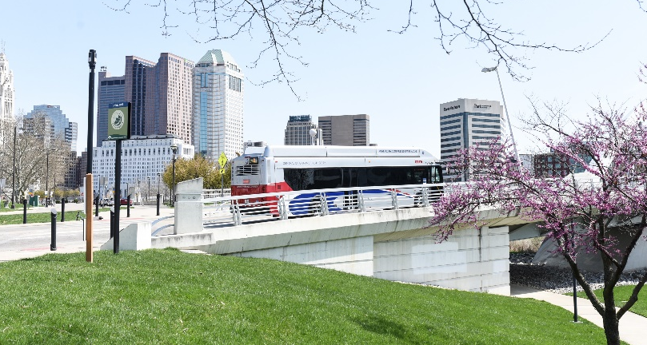
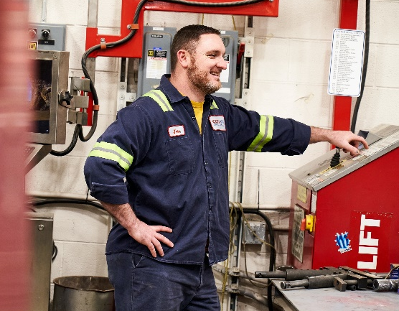
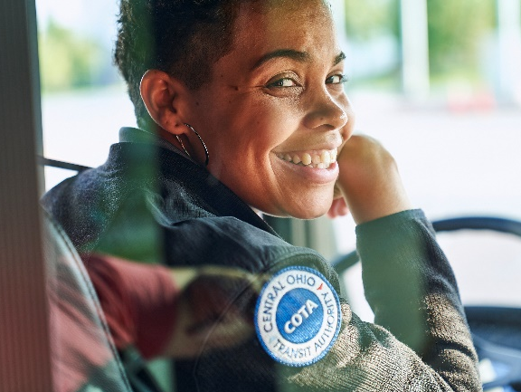
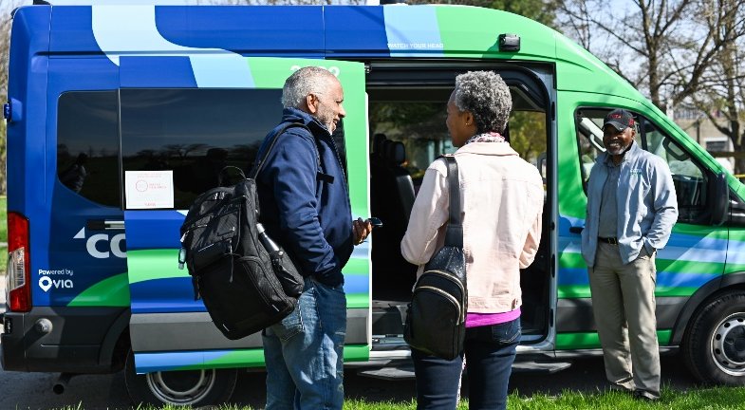
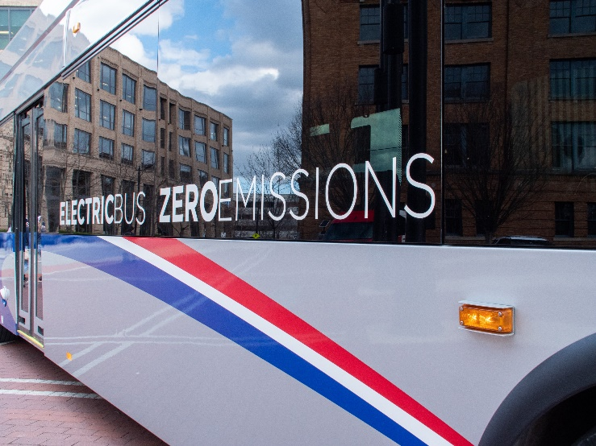
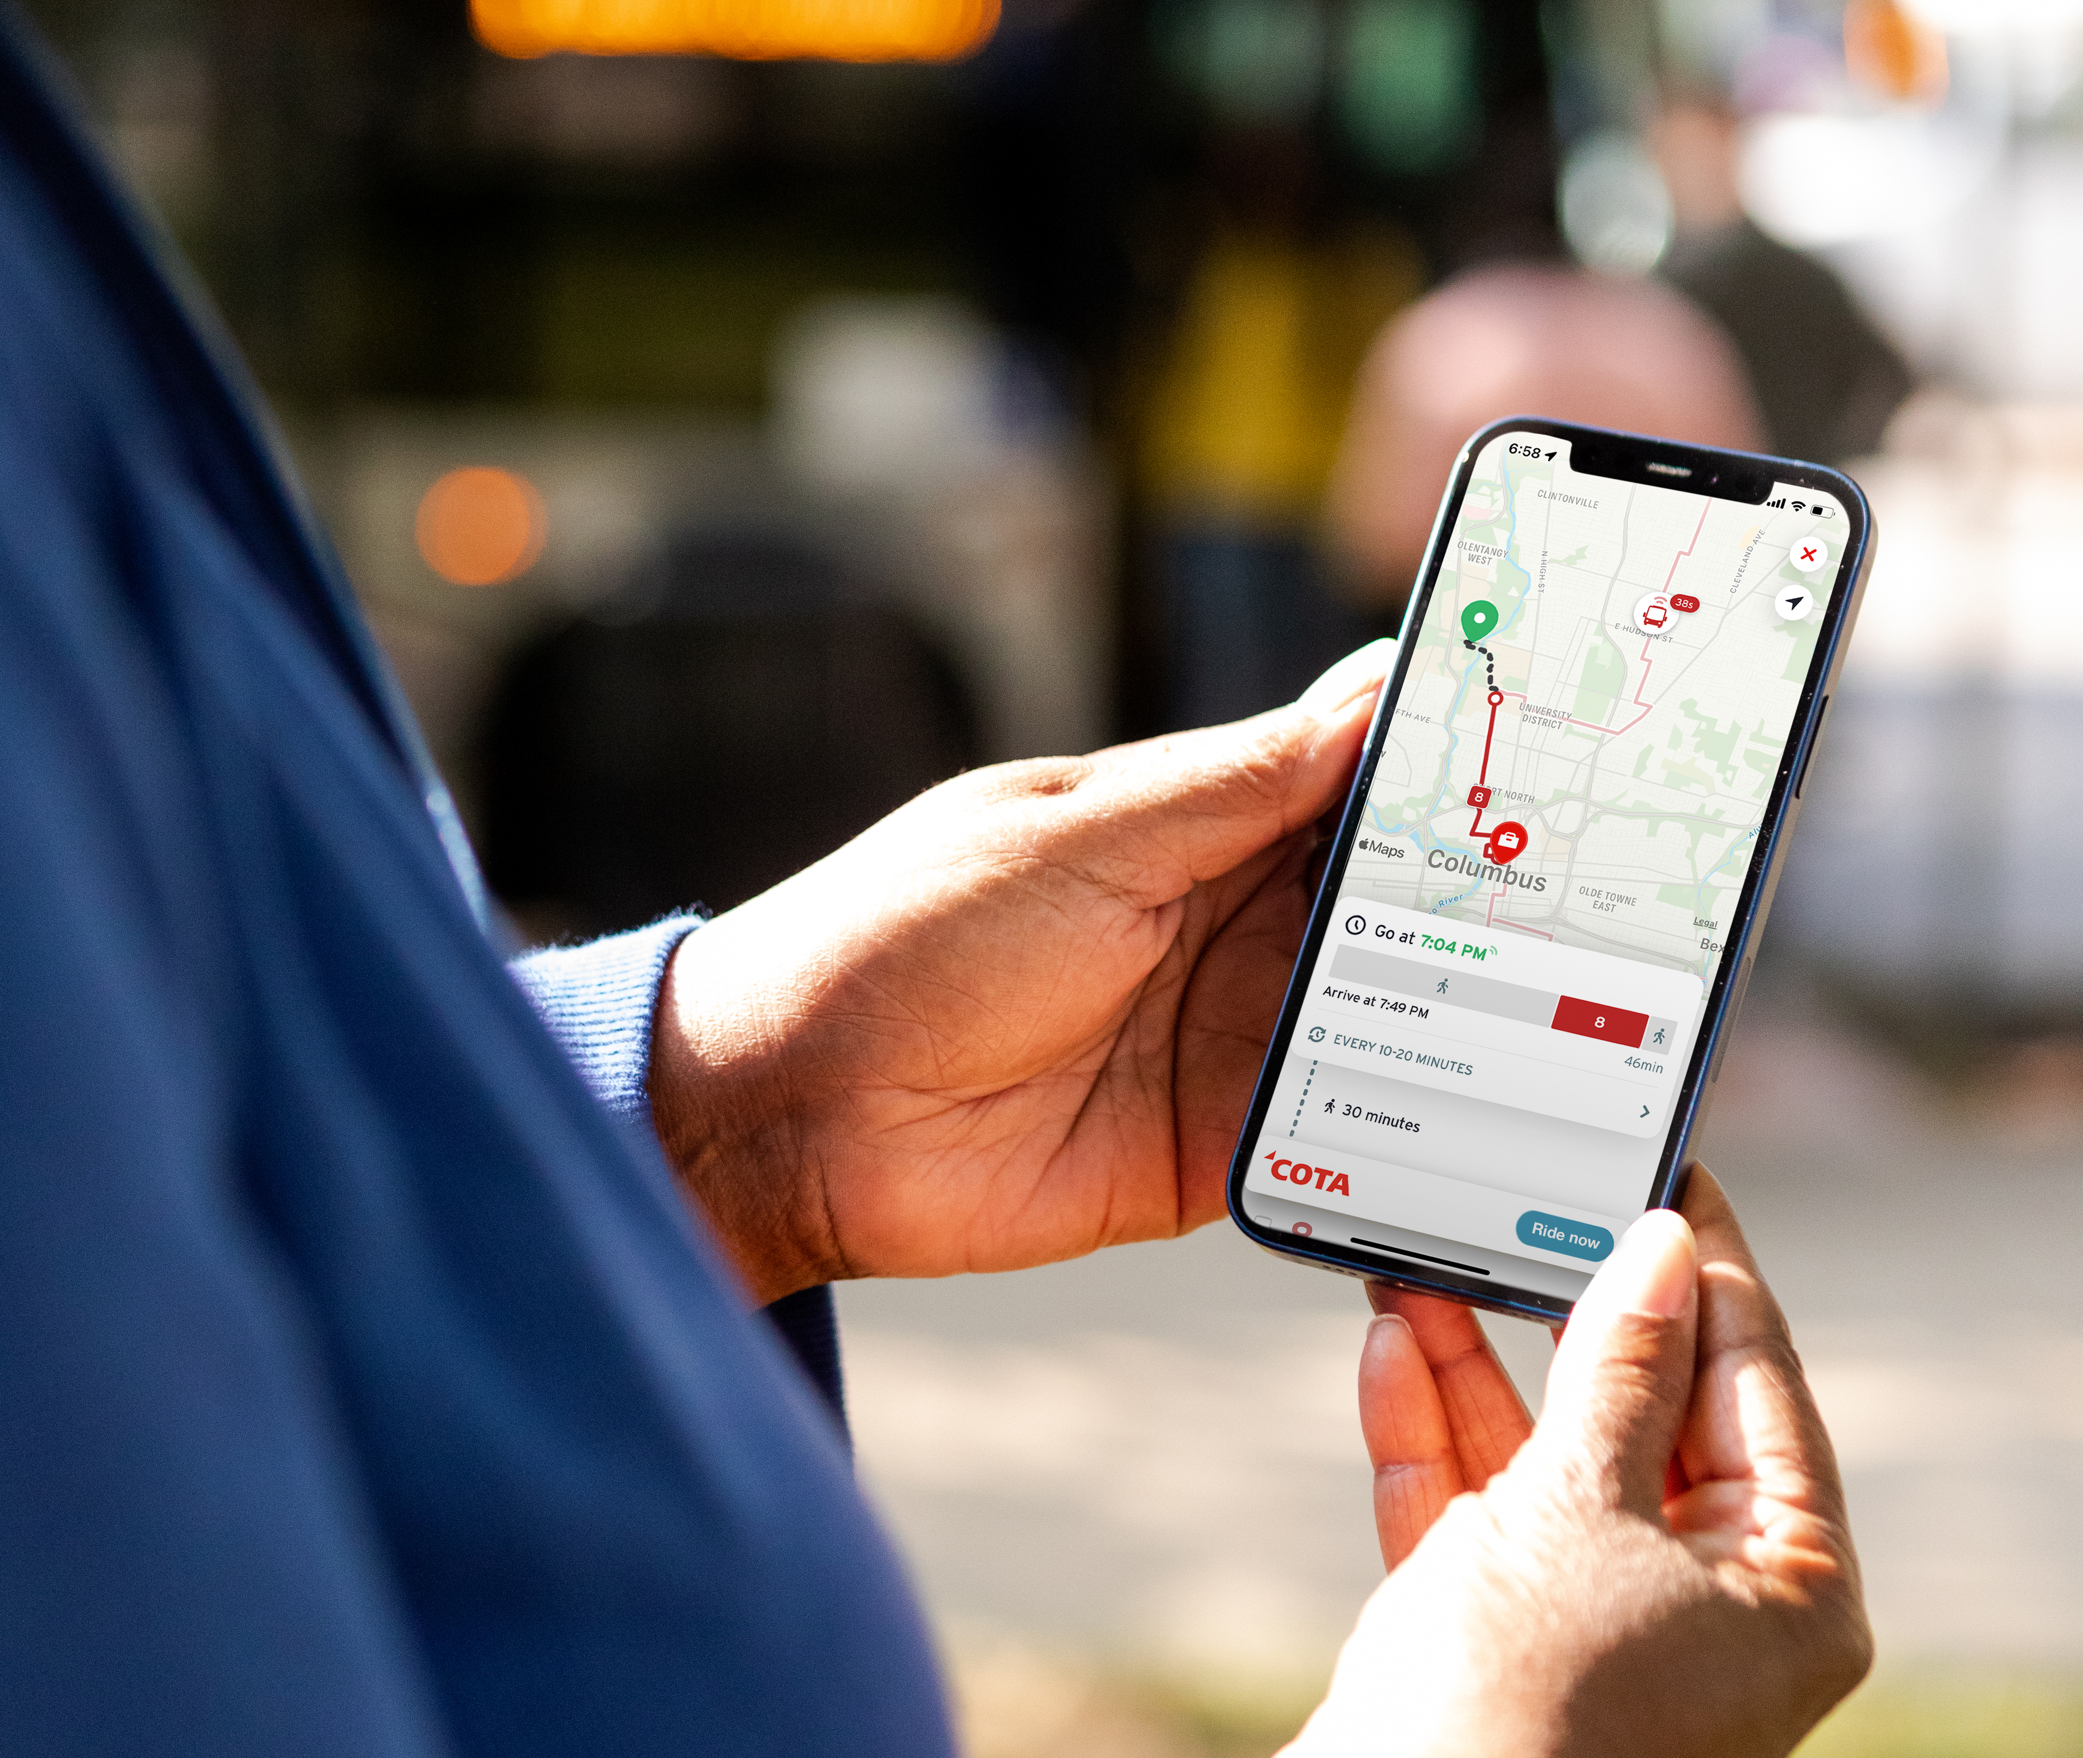
welcome!
THIS MEETING WILL START SHORTLY.

Slide 2
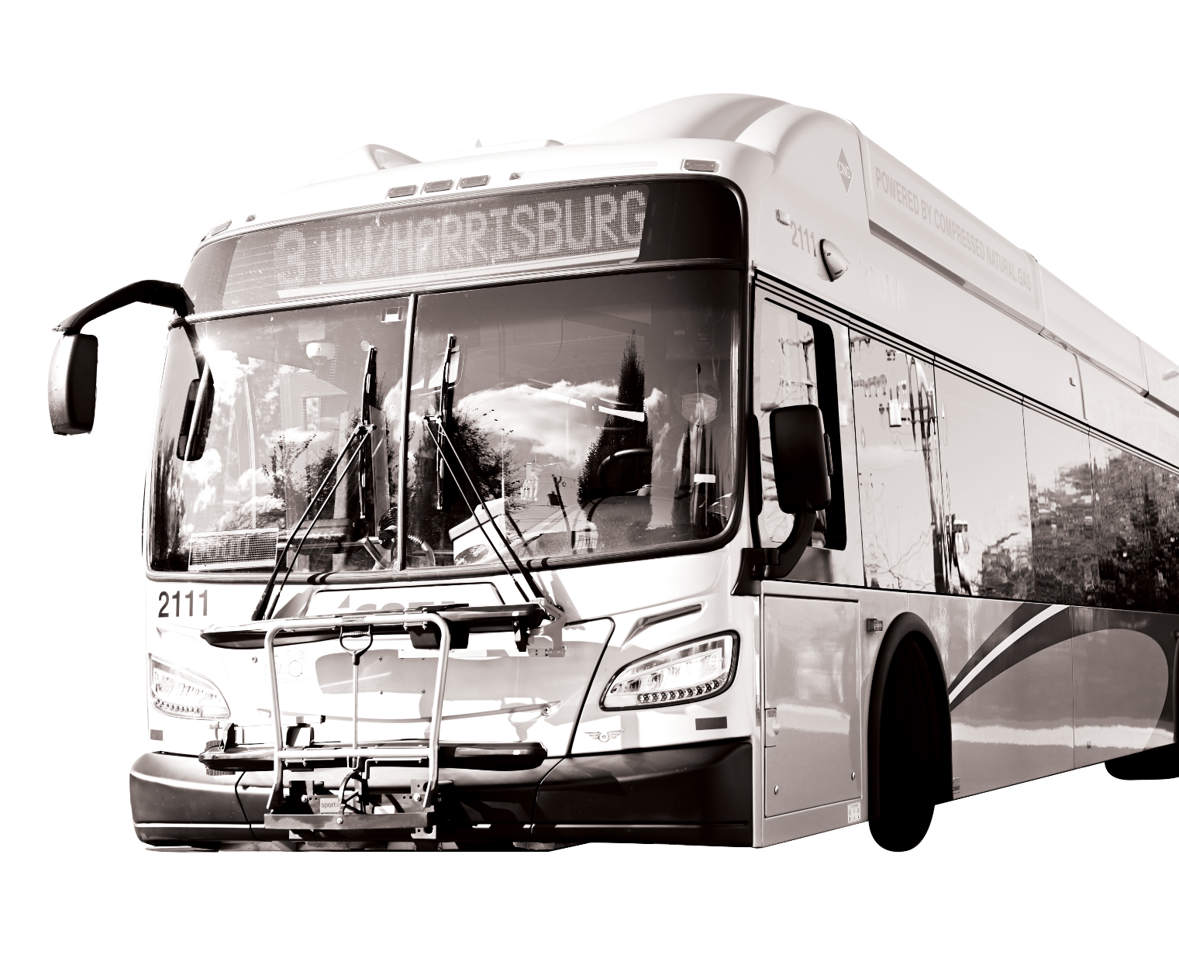
Meeting Format
This meeting is held in-person in the COTA Boardroom located at 33 N. High St. It is also streaming on Facebook Live.
We are also recording this public information meeting. The recording will be posted on our website at COTA.com following the meeting.
HOW TO COMMUNICATE WITH COTA Time for questions and comments is available after the presentation. If joining by Facebook Live, submit comments and questions via the comment box. Please be considerate of meeting attendees and COTA staff.
Feedback can also be submitted at COTA.com/contact or by calling the Customer Care Center at 614-228-1776.

Slide 3
January 2024
SERVICE
CHANGE
MEETINGS
Dec. 7 & 12, 2023

Slide 4
Workforce Challenges
Like most industries in the United States, COTA remains impacted by the nationwide worker shortage. COTA continues to explore creative ways to recruit and hire new Operators in this climate. Thanks to these hiring efforts, COTA restored some services in September 2023 and will maintain these levels in January 2024.
COTA will continue to adjust transit schedules due to unprecedented workforce challenges. We hope to continue adding even more service in future trimesters as we can hire, train and retain more Operators.

Slide 5
Recruitment
Transit agencies across the nation are facing a shortage of Operators, which has resulted in reduced service. COTA has embarked on a robust recruitment campaign to address workforce needs throughout the organization and return to normal service hours as soon as possible. Efforts include:
A revamped and revitalized careers landing page
Internal and external recruitment incentives, including monetary referral and hiring bonuses upwards of $2,000
Making candidates with Commercial Drivers Licenses (CDL) eligible to receive $2,500 sign-on bonuses
A strategic marketing communications campaign that boasts benefits and increased wages
Partnering with local and state organizations to host hiring events

Slide 6
COTA is HIRING!
Anyone interested in a rewarding career at COTA can learn more and apply at COTA.com/careers.
COTA's Operator training wages start at $21.50/hour. Operators can make more than $33/hour after five years.
Comprehensive insurance: medical, dental, vision
Health flexible spending accounts
Retirement/savings benefits: Ohio Public Employees Retirement System (OPERS), Deferred Compensation Plan
Vacations, holiday, sick pay
New: Full-paid family leave for all full-time and part-time COTA employees
New: Domestic partner benefits
New: Monthly student loan payment stipend (after six months)
Biometric screening, fitness and wellness reimbursement
Personal training and development, job advancement and Employee Assistance Program (EAP)

Slide 7
Workforce Outlook for January 2024
COTA’s growing ranks of Transit Operators made it possible to restore service to our community in September 2023. COTA projects a stable number of Operators through January 2024. COTA is not making any service reductions for January 2024.

Slide 8
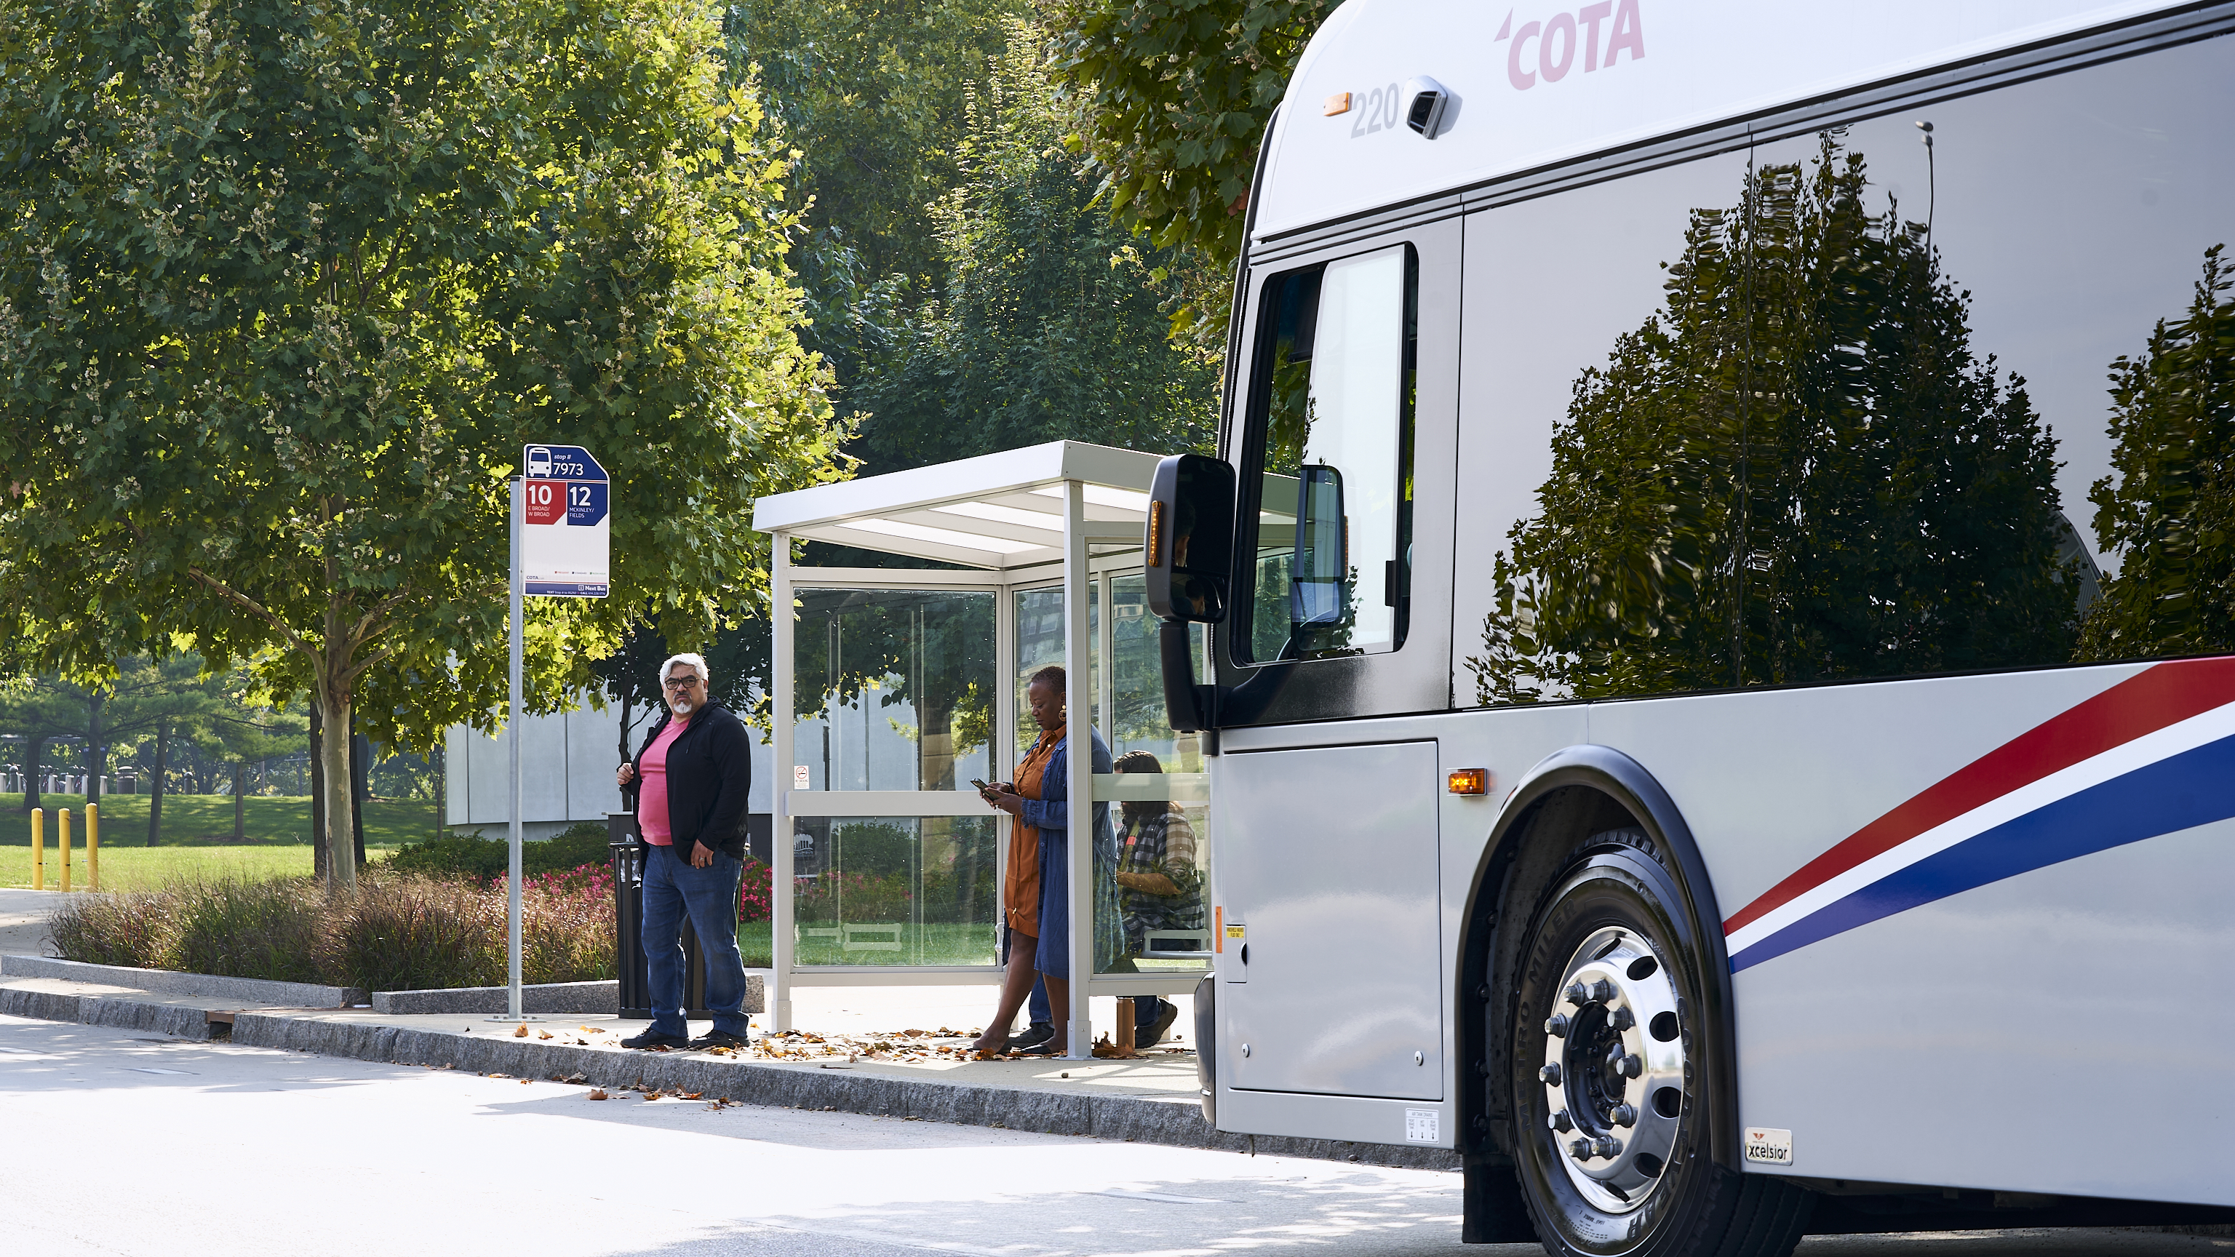
service
CHANGES
The following service changes are final and will begin on Monday, Jan. 1, 2024.
COTA | MOVING EVERY LIFE forward
8

Slide 9
Time and Alignment Changes
The following changes are not dependent on workforce resources increasing.
LINE | CHANGES | RATIONALE
45 New Albany | The inbound morning trip and outbound evening trip will no longer stop at Easton Transit Center. The outbound morning trip and inbound afternoon trip will continue to stop at Easton Transit Center. | Customer request for more direct service between New Albany and downtown Columbus. The new Line 35 is an alternative connection between New Albany and Easton Transit Center.
71 Hilliard | Cemetery Road Park and Ride and Hilliard UMC Park and Ride will close. The new end of line for Line 71 will be Renner Road Park and Ride. | Redevelopment of Hilliard Cemetery Road Park and Ride. Low ridership north of Renner Road Park and Ride.
CMAX | COTA staff will assess options to improve access to CMAX stations. No changes are proposed currently. | Customer request for better access to CMAX after discontinuation of Line 6 on Cleveland Avenue.
Key: rationale / public feedback
Notes:
Line 4 – ridership, projection changes, service hour savings, and changes to operator hours
NE On-Demand – pre pandemic PPH,

Slide 10
Schedule Adjustments
The following changes are not dependent on workforce resources increasing.
LINE | CHANGES | RATIONALE
1 Kenny/Livingston, 2 E Main/ N High, 3 Northwest/Harrisburg, 5 W 5th Ave/Refugee, 8 Karl/S High/Parsons, 10 E Broad/ W Broad, 11 Bryden/Maize, 32 N Broadway | Minor schedule adjustments on weekdays | Improve on-time performance
25 Brice & 33 Henderson | Minor schedule adjustments on all days | Improve on-time performance
Key: rationale / public feedback
Notes:
Line 4 – ridership, projection changes, service hour savings, and changes to operator hours
NE On-Demand – pre pandemic PPH,

Slide 11
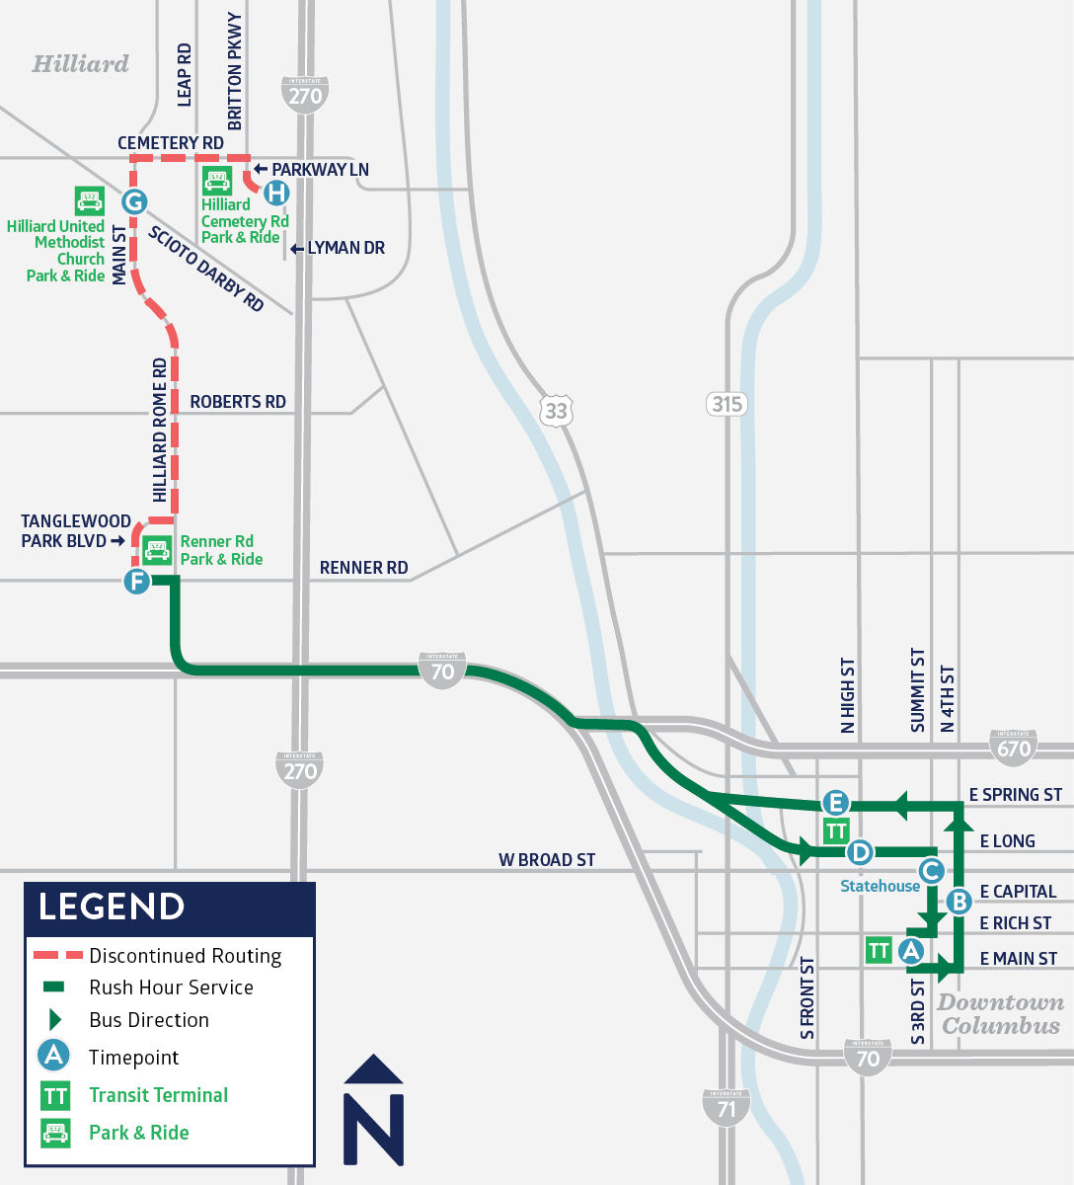
Line 71 ends at Renner Road
Due to low ridership and a development proposal from the City of Hilliard, the Hilliard Cemetery Road Park and Ride will close.
COTA will use Renner Road Park and Ride as the new end of line location for Line 71 in Hilliard. Line 71 will no longer serve stops north of Renner Road Park and Ride, including at the Hilliard United Methodist Church Park and Ride.

Slide 12
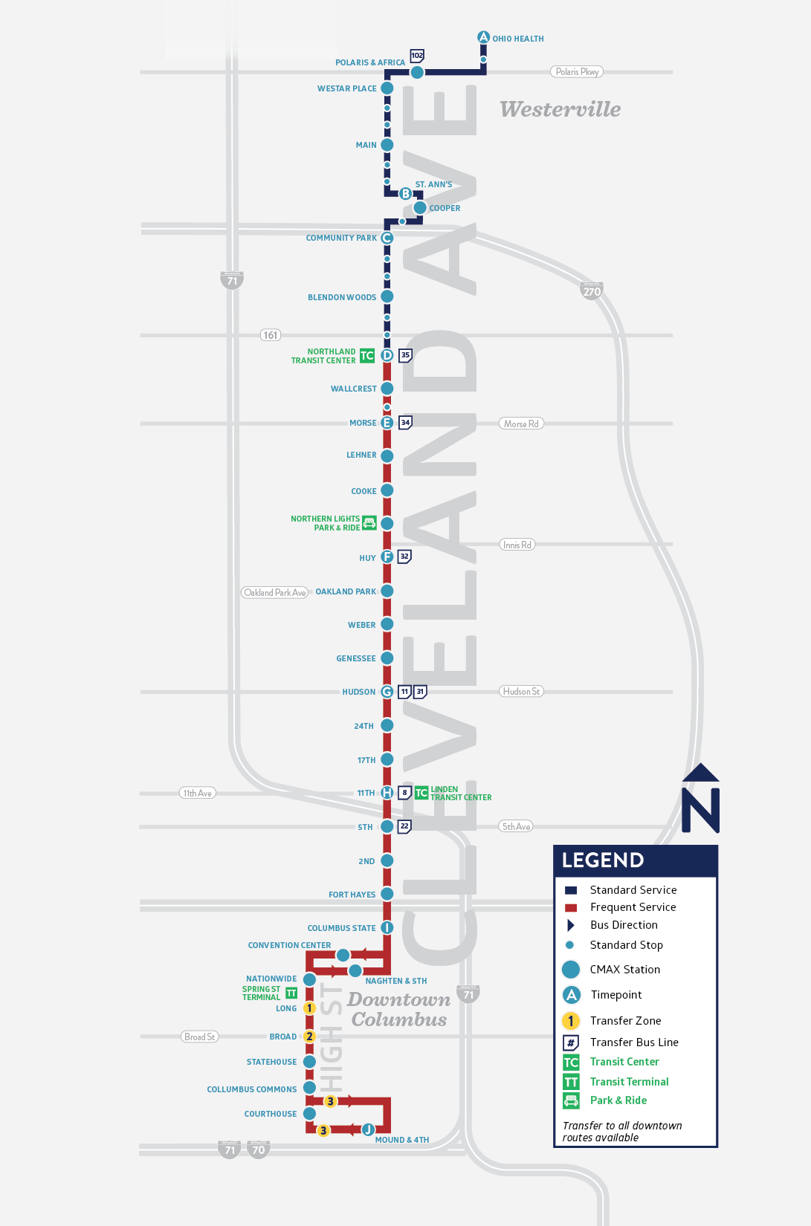
Improving Access to CMAX Service
Streamlining the number of stops along Cleveland Avenue is one factor that helps CMAX travel faster than a typical transit line. However, some customers have trouble accessing stops that are spaced farther apart.
COTA is seeking feedback on how to better balance the competing interests of fast CMAX service with more accessible station locations. Options being considered include adding one or more new CMAX stations along Cleveland Avenue.
No changes are proposed for January 2024. COTA staff will continue to evaluate CMAX and propose changes during a future service change.

Slide 13
Q&A Chat
Have a question about the proposed service changes?
If joining in-person, please wait for the host to call guests up to the podium.
If joining via Facebook Live, please comment with questions in the livestream.
Visit COTA.com/contact to suggest how we can improve COTA’s service.
​
Public comment meetings for the May 2024 Service Change will be held January 16 at noon and January 18 at 6p.m.

